Slide 1

Adding SakaiPlus to Your Current LMS
Dr. Charles R. Severance
University of Michigan School of Information

Slide 2
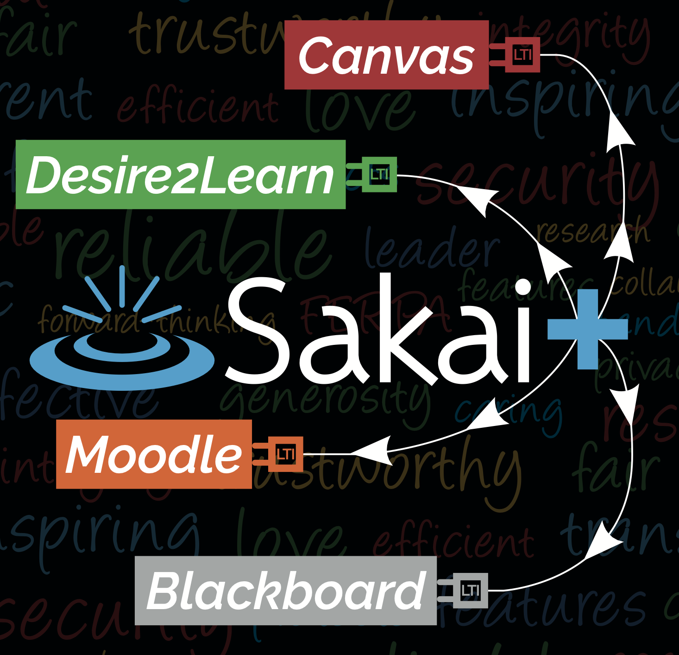
SakaiPlus TL;DR
Plugs an entire LMS into an Enterprise LMS with a single link
Rosters and Grades are synchronized using LTI Advantage
Cost and IT Support are on par with a single LTI Tool
Give your innovative faculty a choice

Slide 3
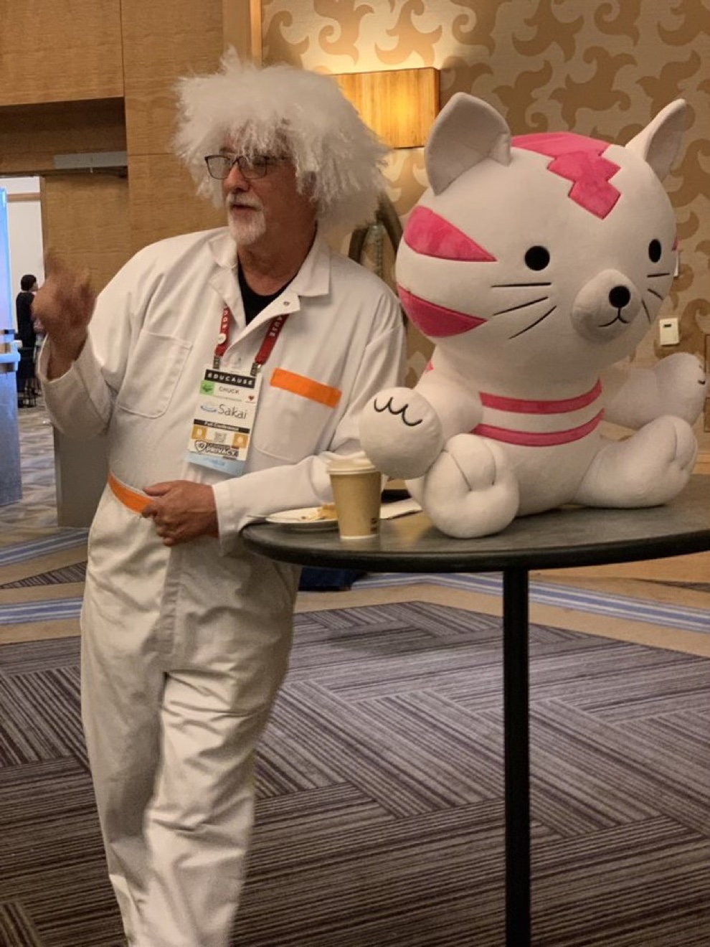

One Year Ago

Slide 4
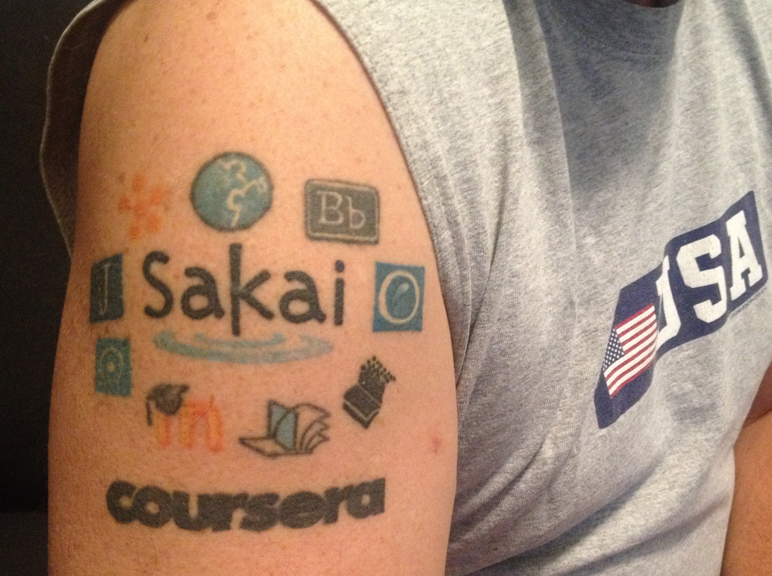
Dr. Chuck
Co-Founder Sakai 2004
Founded Learning Tools Interoperability (LTI) 2004
Founded Common Cartridge (2006)
Faculty member University of Michigan School of Information 2007-present
MOOC Innovator – Coursera 2014
Current Chair of the Sakai PMC

Slide 5
SakaiPlus @ University of Michigan
Initial Development and Testing – 2021
Summer 2022
Approval for limited production use in the School of Information
Privacy training
Hosted on UMich-owned AWS resources
Fall 22 – Sakai 22+Beta – One Course
Winter 23 – Sakai 23+Beta – Three Courses
Summer 2023 – Released in Sakai 23

Slide 6
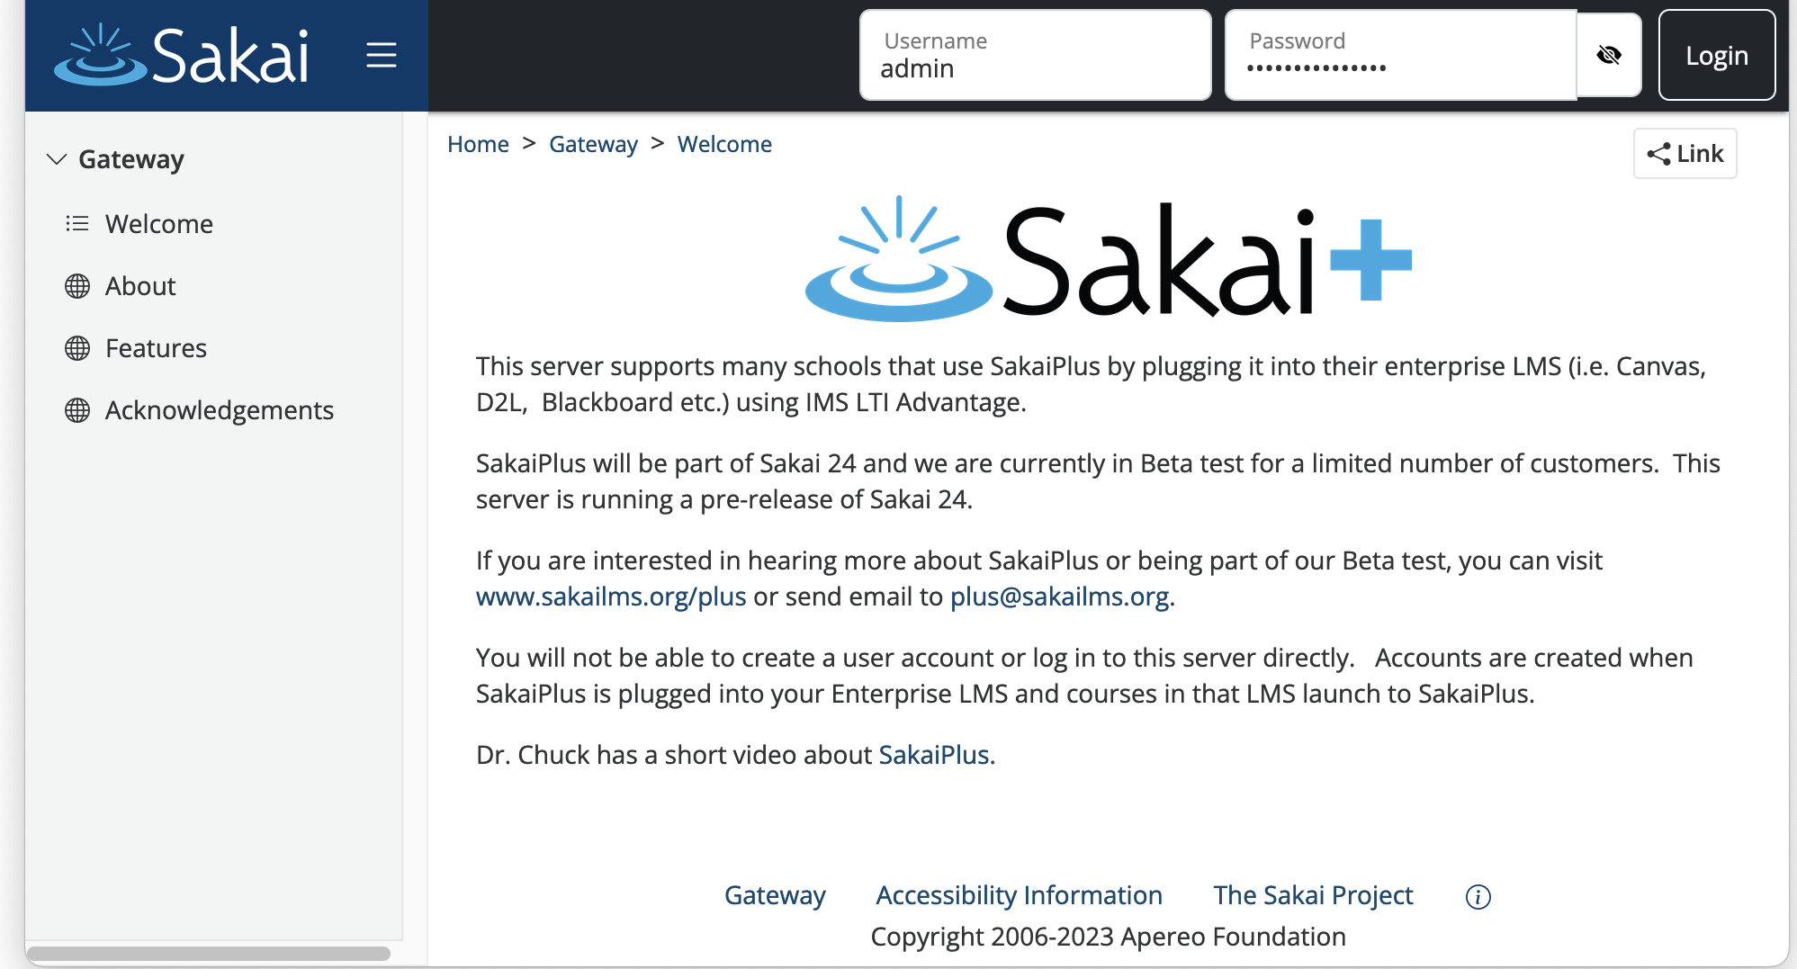
https://plus.sakaicloud.com – Beta Ready

Slide 7
SakaiPlus Philosophy
No local customization
Easy Upgrades
AMI Subscription

Slide 8
Living inside the Enterprise LMS
Upgrade early and often – track the latest
Less concern regarding performance and scaling
No standup meetings ☺
Always can fall back to the enterprise LMS – Hybrid (Screen shot of modules - from Fall 23)

Slide 9
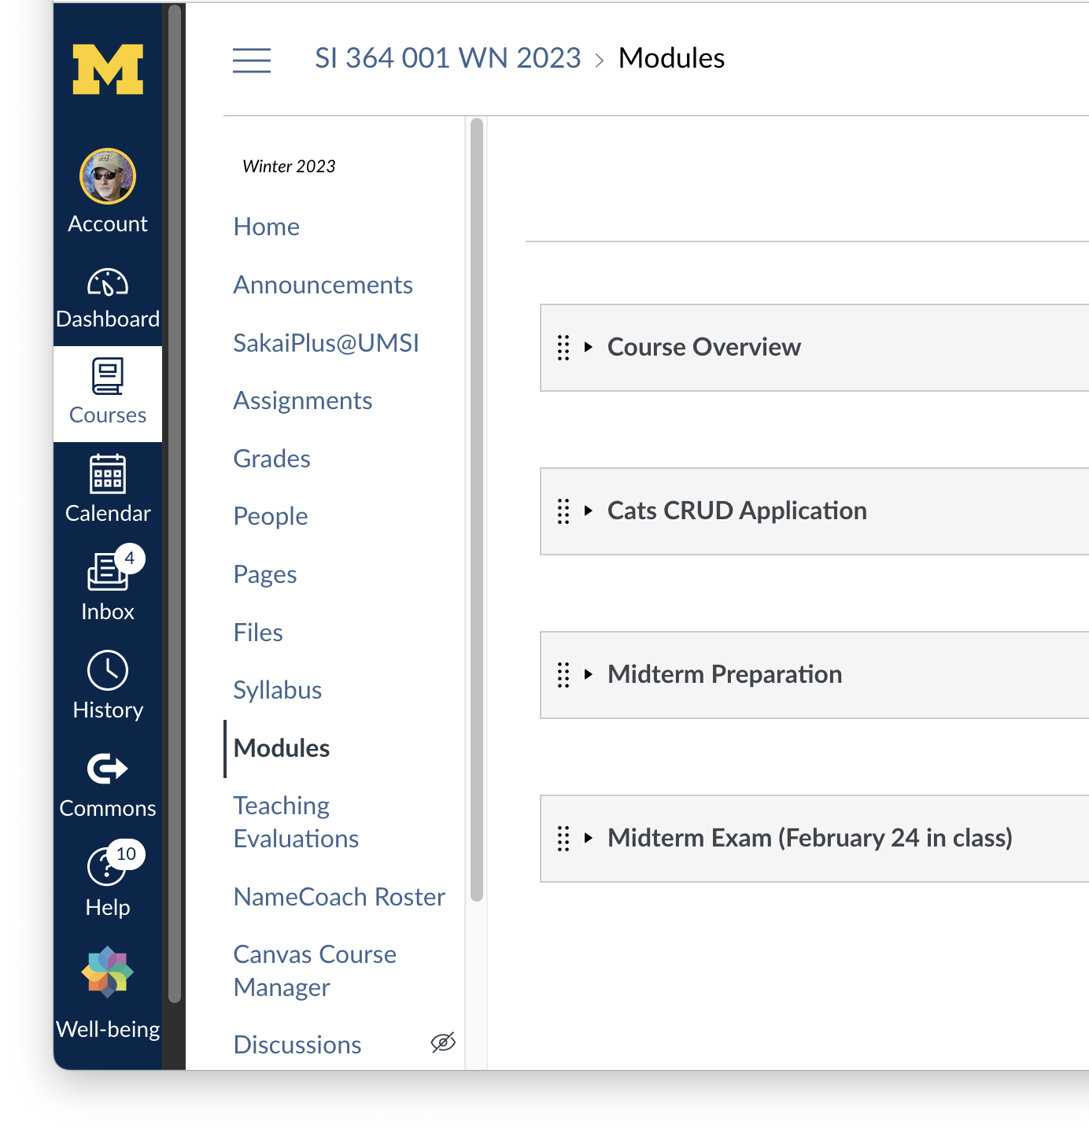
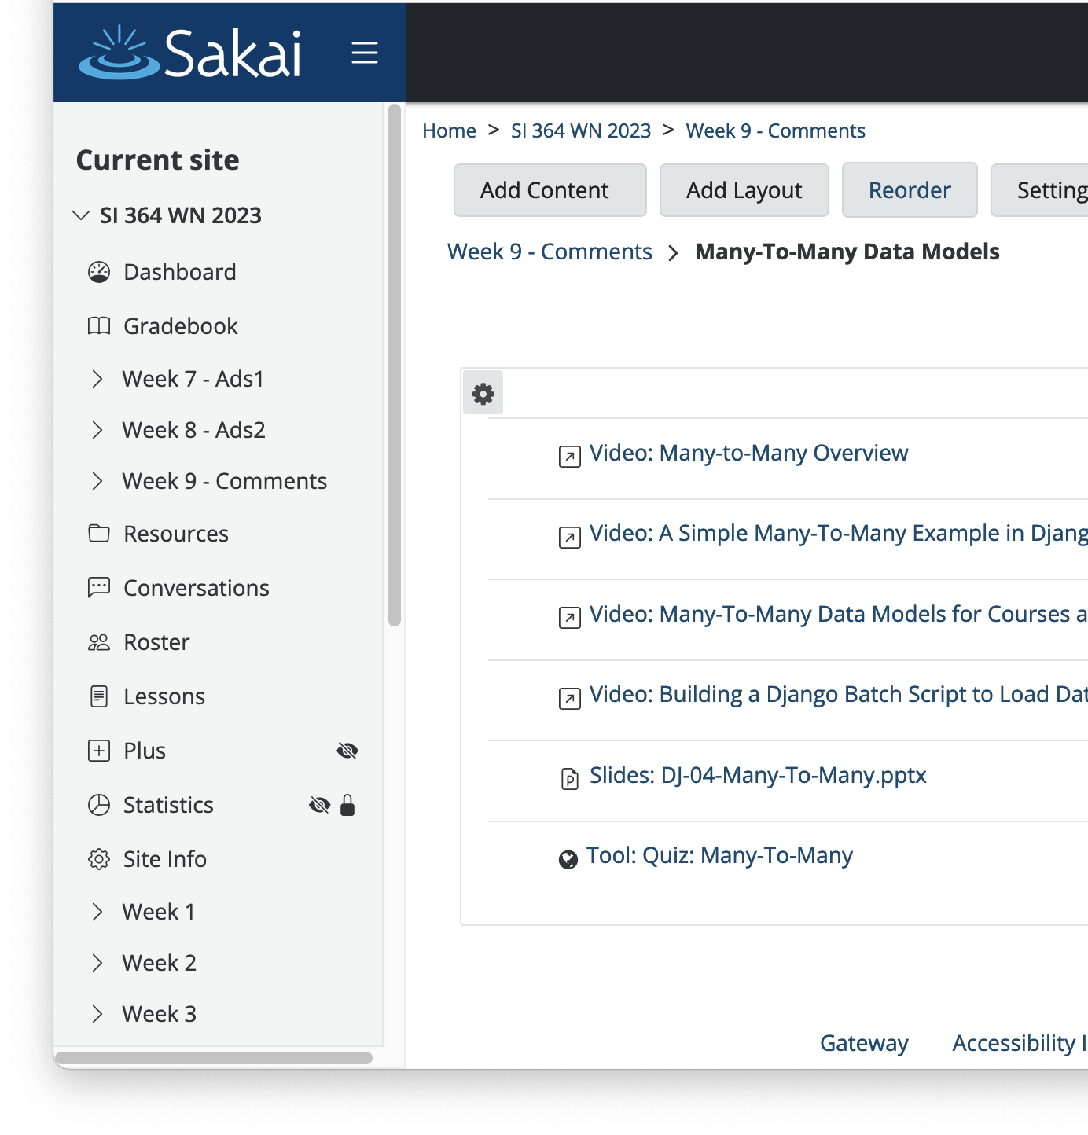
#NERCOMP23

Slide 10
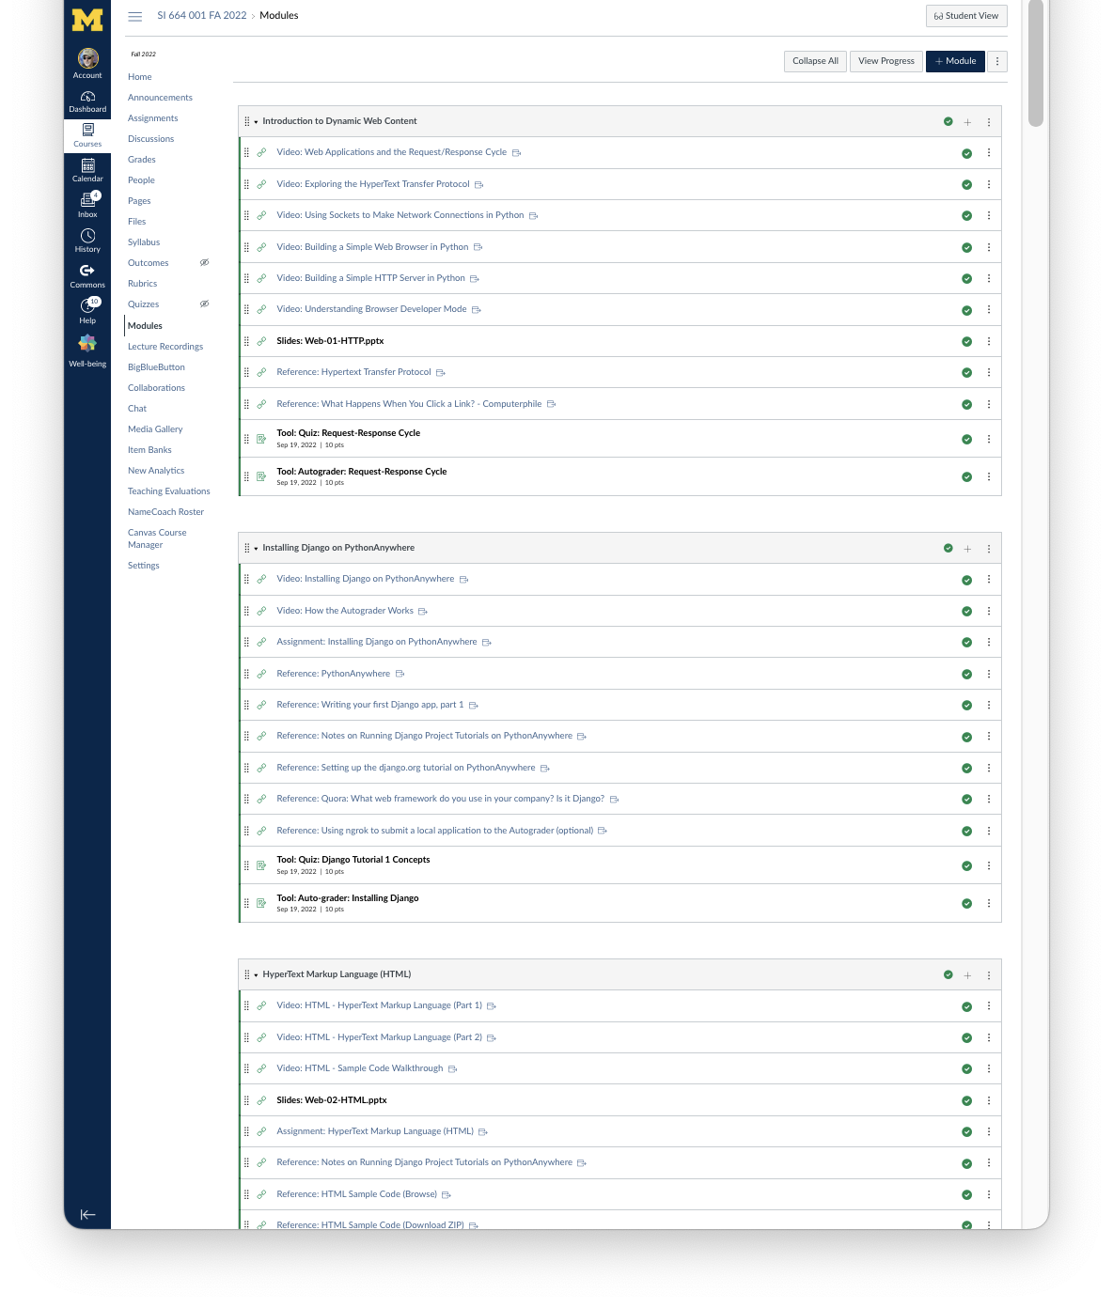
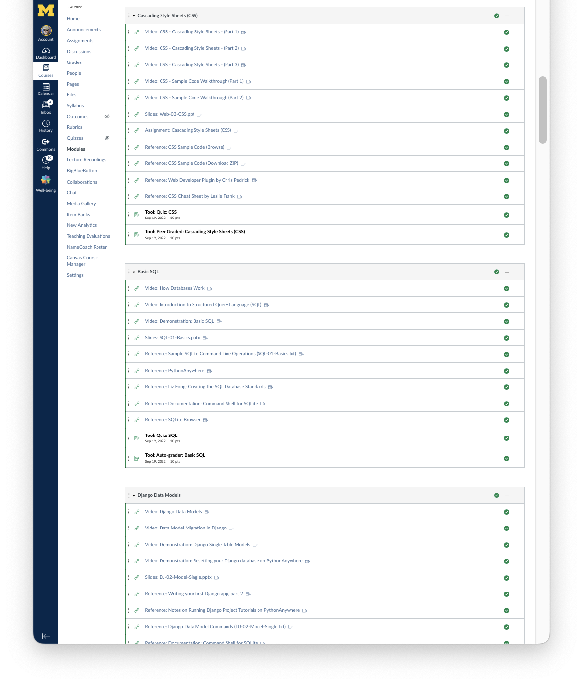
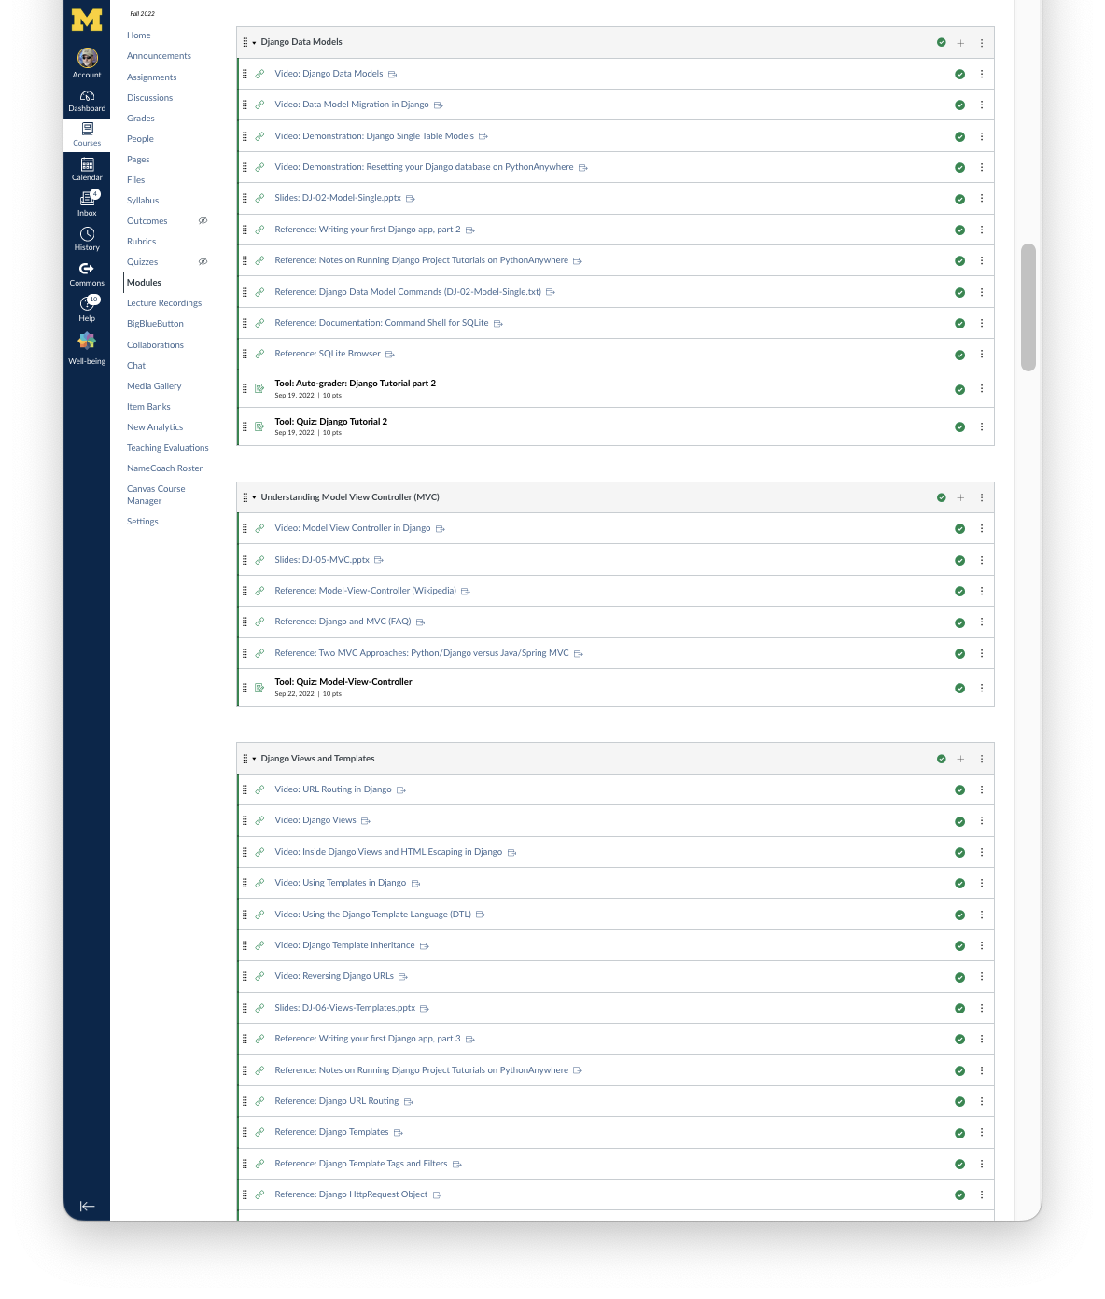
My Fall 22 Modules in Canvas (1/3)

Slide 11

Campus IT Perspective
Experiences Using SakaiPlus with Canvas at University of Michigan

Slide 12
Demo

Slide 13

Instructor Perspective
I am teaching the way I like
I have much more control over the student UX because of Lessons
I am not stuck in an LMS that will never change or grow.

Slide 14

Student Perspective
Zero complaints
Students picked it up right away
They use resources outside the LMS across many classes - this was like a publisher site associated with a book
They even used Sakai features like the Tasks tool

Slide 15
My Future Research > 1 LMS
My goal is to pave the way for multiple LMS systems on a campus
I am adding a light LMS capability my Tsugi Learning Object Repository so can teach right in my learning object repository
I am working with a grad student and trying to convince her to build a prototype Virtual Reality LMS and plug it in using LTI Advantage

Slide 16
Questions?
Learn more:
SakaiLMS: www.sakailms.org
SakaiPlus: plus@sakailms.org
Notes:
SD

